Slide 1
Lab 4: Multivariate Kalman filter
Learning objectives:
Skill to develop multivariate time-series model
Use simulation to evaluate model fit
Visualize uncertainty during forecast period

Slide 2
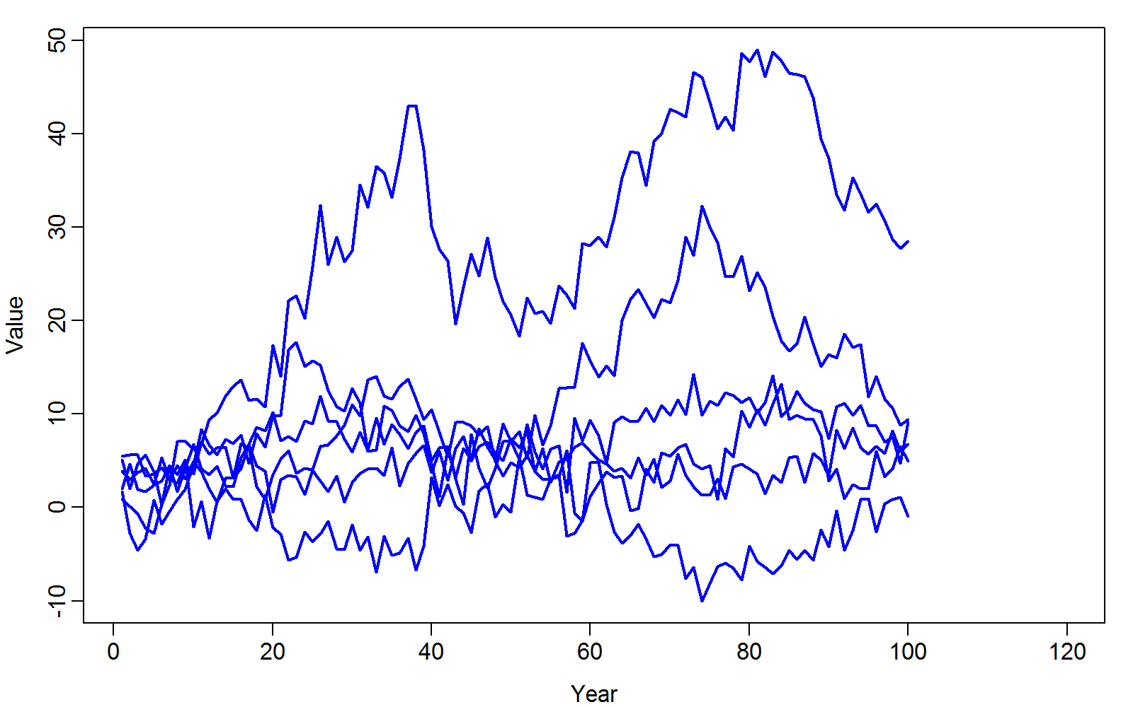
Given timeseries from multiple populations…

Slide 3
Given timeseries from multiple populations…
How do we estimate parameters in data-generating process?
How do we forecast future values?

Slide 4
Given timeseries from multiple populations…
Steps
Hypothesize data-generating process
Estimate parameters using maximum likelihood
Propagate uncertainty using delta method
Evaluate model fit and repeat steps #1-3

Slide 5

Given timeseries from multiple populations…
Steps
Hypothesize data-generating process
$$x_{t+1}\sim MVN(x_{t},Σ_{x})$$
$$y_{t,p}\sim Normal(x_{t,p},σ_{M}^{2})$$
$$\text{Where}$$
$$Σ_{x}=LL^{T}$$

Slide 6
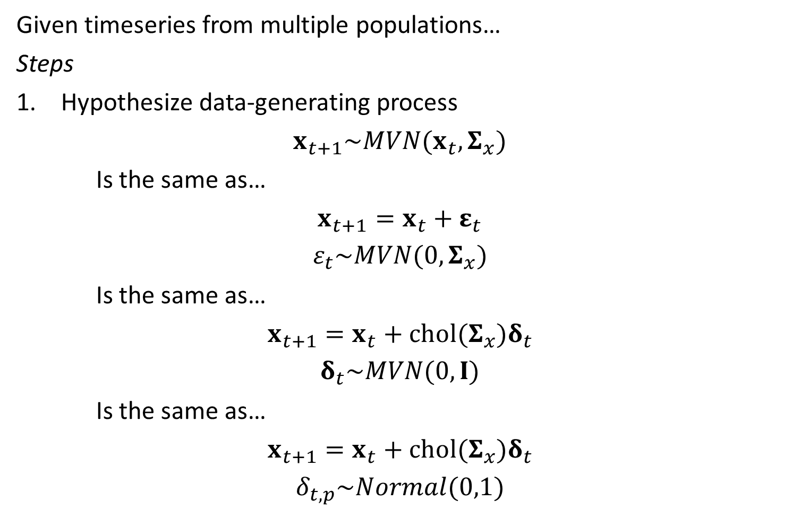
Given timeseries from multiple populations…
Steps
Hypothesize data-generating process
$$x_{t+1}\sim MVN(x_{t},Σ_{x})$$
Is the same as…
$$x_{t+1}=x_{t}+ε_{t}$$
$$ε_{t}\sim MVN(0,Σ_{x})$$
Is the same as…
$$x_{t+1}=x_{t}+chol(Σ_{x})δ_{t}$$
$$δ_{t}\sim MVN(0,I)$$
Is the same as…
$$x_{t+1}=x_{t}+chol(Σ_{x})δ_{t}$$
$$δ_{t,p}\sim Normal(0,1)$$
Notes:
Top = nice way to write in paper
Bottom = efficient for coding, no pesky matrix inversions
Three different parameterizations…we should get the same MLEs either way, but sp.Hess (ie the sparseness of the Hessian) will vary and therefore the length of the computations

Slide 7
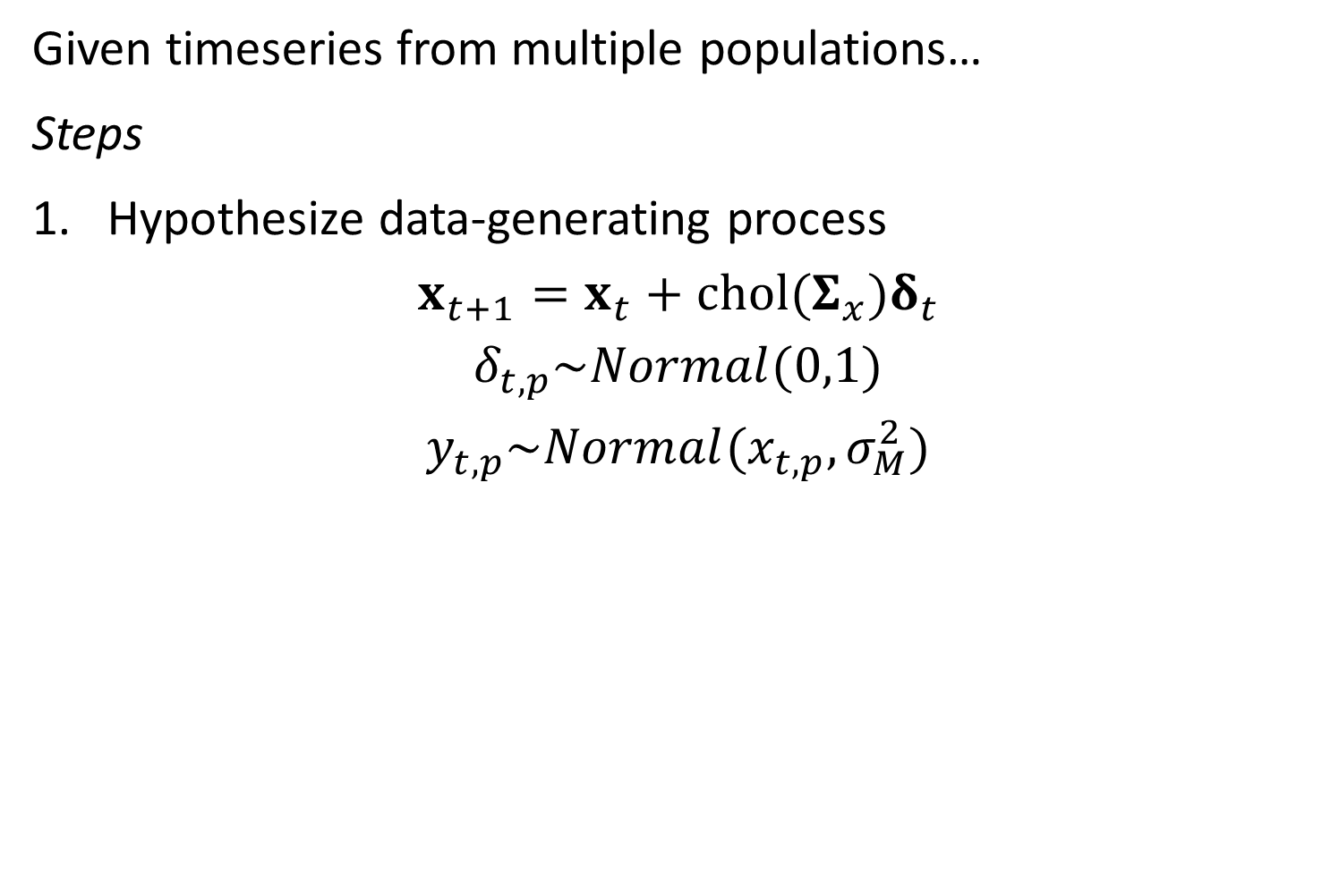
Given timeseries from multiple populations…
Steps
Hypothesize data-generating process
$$x_{t+1}=x_{t}+chol(Σ_{x})δ_{t}$$
$$δ_{t,p}\sim Normal(0,1)$$
$$y_{t,p}\sim Normal(x_{t,p},σ_{M}^{2})$$

Slide 8
[look at code]
Notes:
Cholesky decomp aka loadings matrix
.transpose() is a C function to do a matrix transpose
Epsilon_tp.setZero() sets all the elements to zero
Jim uses a loop to do matrix multiplication since it’s easier to debug (matrix dimension stuff)
Don’t need to eval mvn density, because we’re defining the errors as normal and then multiplying by the Cholesky decomp. Way faster since we don’t need to compute a mvn density
More on the R side…
Parameters$P is a full matrix, but we only need (or want to estimate the lower half)
Use map to turn off the upper part (21 elements– table(names(Obj$Par))
Starting values are 0 and will always be 0

Slide 9
Given timeseries from multiple populations…
Steps
2. Estimate parameters using maximum likelihood
Param | Starting value | Lower | MLE | Upper | Final gradient
log_VarM | 0 | -Inf | 0.404701 | Inf | 3.22E-08
x0_p | 0 | -Inf | 3.423018 | Inf | -2.20E-08
x0_p | 0 | -Inf | 3.249082 | Inf | 1.57E-08
x0_p | 0 | -Inf | -0.61913 | Inf | -1.12E-08
x0_p | 0 | -Inf | 2.932184 | Inf | 2.72E-09
x0_p | 0 | -Inf | 1.07471 | Inf | 5.29E-09
x0_p | 0 | -Inf | 4.304056 | Inf | -1.24E-08
Lp | 2.134858 | -Inf | 0.384887 | Inf | -6.04E-08
Lp | -0.75926 | -Inf | -0.30681 | Inf | 4.43E-08
Lp | 0.250707 | -Inf | -1.21852 | Inf | -3.07E-08
Lp | 1.459138 | -Inf | 0.656695 | Inf | 1.03E-08
Lp | 1.041312 | -Inf | -0.75322 | Inf | 1.48E-08
Lp | 1.630788 | -Inf | -0.15517 | Inf | -3.28E-08
Lp | 0.047519 | -Inf | 0.460655 | Inf | 2.84E-07
Param | Starting value | Lower | MLE | Upper | Final gradient
Lp | -0.54774 | -Inf | 1.334437 | Inf | -1.62E-07
Lp | -0.67224 | -Inf | -0.49813 | Inf | 5.75E-08
Lp | -0.31427 | -Inf | 1.787124 | Inf | 8.35E-08
Lp | 0.185839 | -Inf | -0.07834 | Inf | -1.99E-07
Lp | 1.048228 | -Inf | 0.812711 | Inf | 4.48E-09
Lp | -0.08609 | -Inf | 0.315512 | Inf | -1.30E-09
Lp | -1.28034 | -Inf | -0.95924 | Inf | -8.74E-09
Lp | 2.15703 | -Inf | -1.07585 | Inf | 6.54E-09
Lp | 0.122517 | -Inf | -0.11135 | Inf | -3.72E-08
Lp | 1.314569 | -Inf | 1.541856 | Inf | 3.65E-08
Lp | 1.243474 | -Inf | 0.603224 | Inf | -4.91E-08
Lp | 0.403457 | -Inf | -3.64E-09 | Inf | 1.13E-06
Lp | 3.002462 | -Inf | -6.72E-09 | Inf | -3.33E-06
Lp | 0.966776 | -Inf | -1.24E-12 | Inf | -7.53E-10
Notes:
Newton step gets the gradient really small

Slide 10
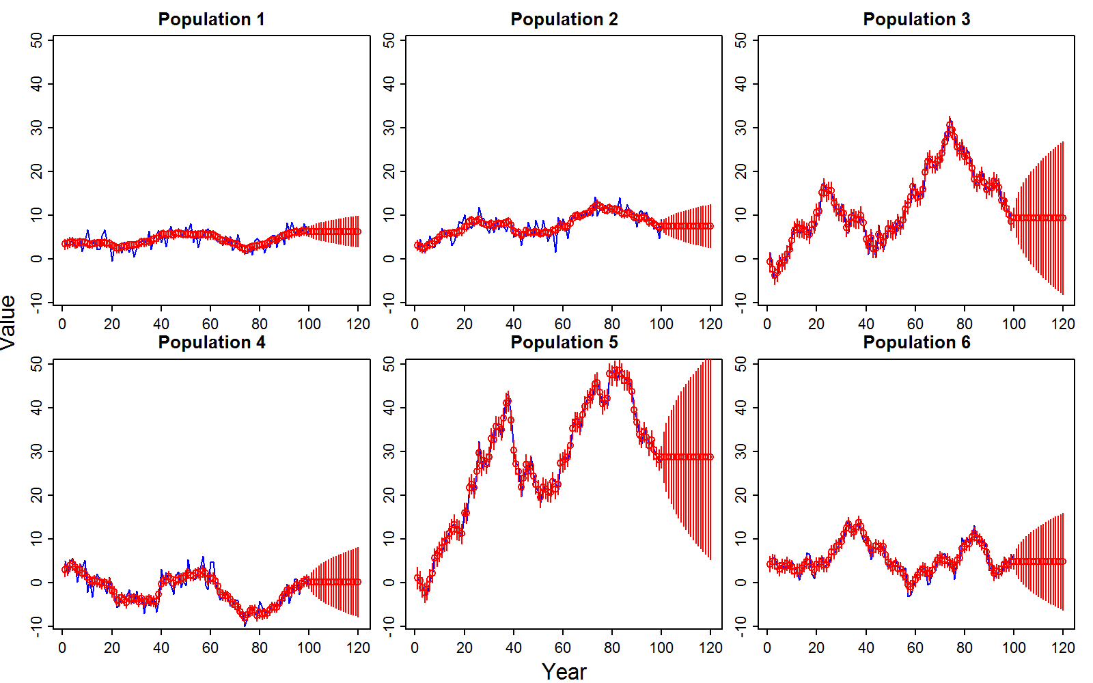
Given timeseries from multiple populations…
Steps
3. Propagate uncertainty using delta method
Notes:
Look at the predictions and the uncertainty
This is a random walk, so variance goes to infinity as time goes to infinity
SE^2 increases linearly with time
Useful features of forecast intervals? Harder to predict into the future, harder for more variable popualtions
Forecast intervals if missing years 20-80? Prediction is linear slope between them, and Ses would be narrow at adjacent to data spots and fatter in the middle

Slide 11
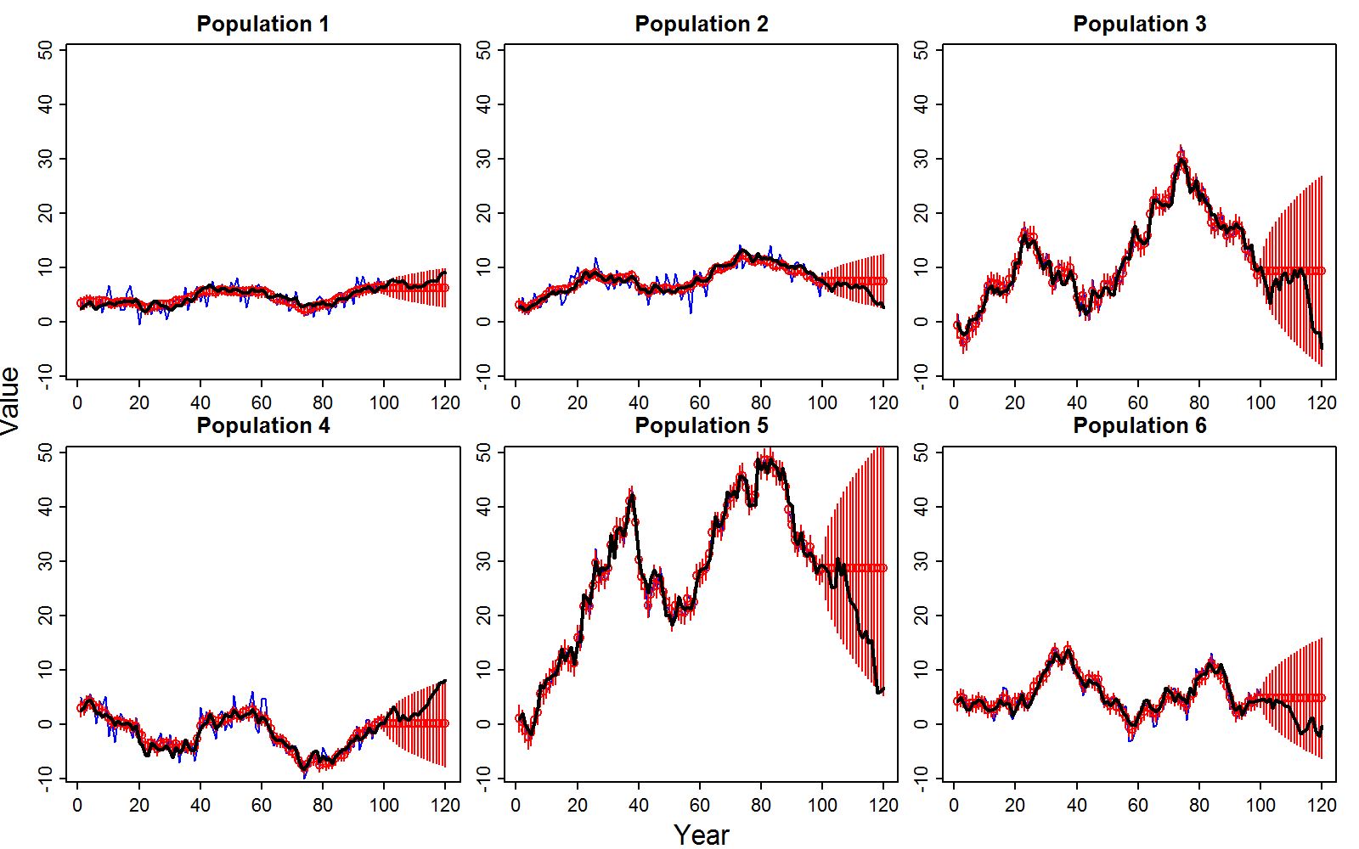
Given timeseries from multiple populations…
Steps
3. Propagate uncertainty using delta method
Notes:
True values in black
Generaly get coverage 95% of the time, so that looks good

Slide 12
Given timeseries from multiple populations…
Steps
3. Propagate uncertainty using delta method

Slide 13
Given timeseries from multiple populations…
Steps
4. Evaluate model fit and repeat steps #1-3
Methods to evaluate fit
Inspect residuals
Compare data and its predictive distribution given parameters
Conduct a simulation experiment
Notes:
Simulate new data from predicted model…are they centered around the observed data?

Slide 14
Given timeseries from multiple populations…
Steps
4. Evaluate model fit and repeat steps #1-3
Simulation experiment
Simulate random effects given fixed effects
Simulate data given fixed and random effects
Re-fit model
Compare MLE from re-fits to original fits
Replicated estimates should be centered on original fits

Slide 15
[look at code]
Notes:
Use new feature in TMB called simulate
// Simulate random effects
// See: http://kaskr.github.io/adcomp/Simulation.html
SIMULATE { for( int t=0; t<nt; t++){ for( int p=0; p<np; p++){ delta_tp(t,p) = rnorm( Type(0), Type(1) ); }} }
Simulate new values that overwrite whatever parameters you want
Separabiltiy—check the sparseness of the Hessian
Very dense if ew look at the random effects!
Image(inv….)
100 parameteric bootstraps—simulate a new dataset given the MLEs…estimate again, and the resulting params should be centered around values from original model
Difference is measure of expected bias
Need simulate statement in cpp for delta tp because we want new random effects
# function to get simulated data from TMB code, Obj is the results/object with MLEs
SimData <- Obj$simulate(par=Obj$env$last.par, complete=TRUE)
Good for: developing simulation model WHILE developing the estimation model
See also checkConcistency tmb fiunction, which does also require a simulation command

Slide 16
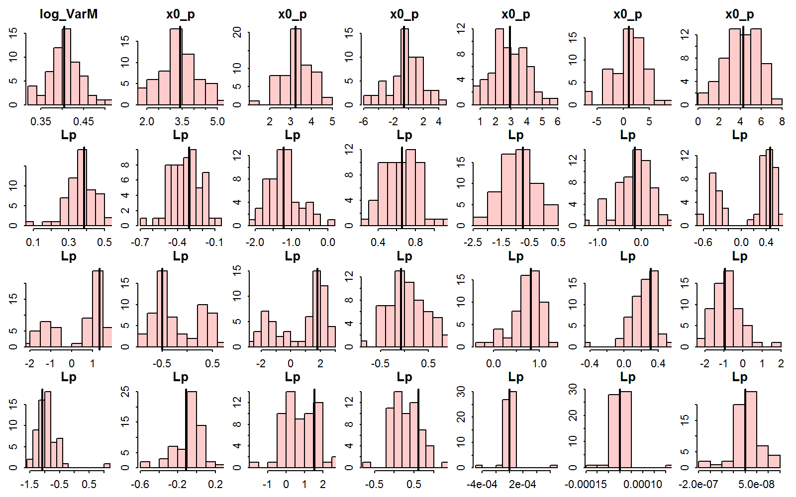
Given timeseries from multiple populations…
Steps
4. Evaluate model fit and repeat steps #1-3
Notes:
Looks good
Lp a bit off sometimes--- can multiply a row of Cholesky decomp by -1 and it won’t change anything

Slide 17
Summary
Can hindcast and forecast abundance with useful uncertainty intervals
Can assess model fit using simulation
A Kalman filter forecasts future abundance equal to last estimated state
Strong benefit to using biological information to inform state-transitions

Slide 18
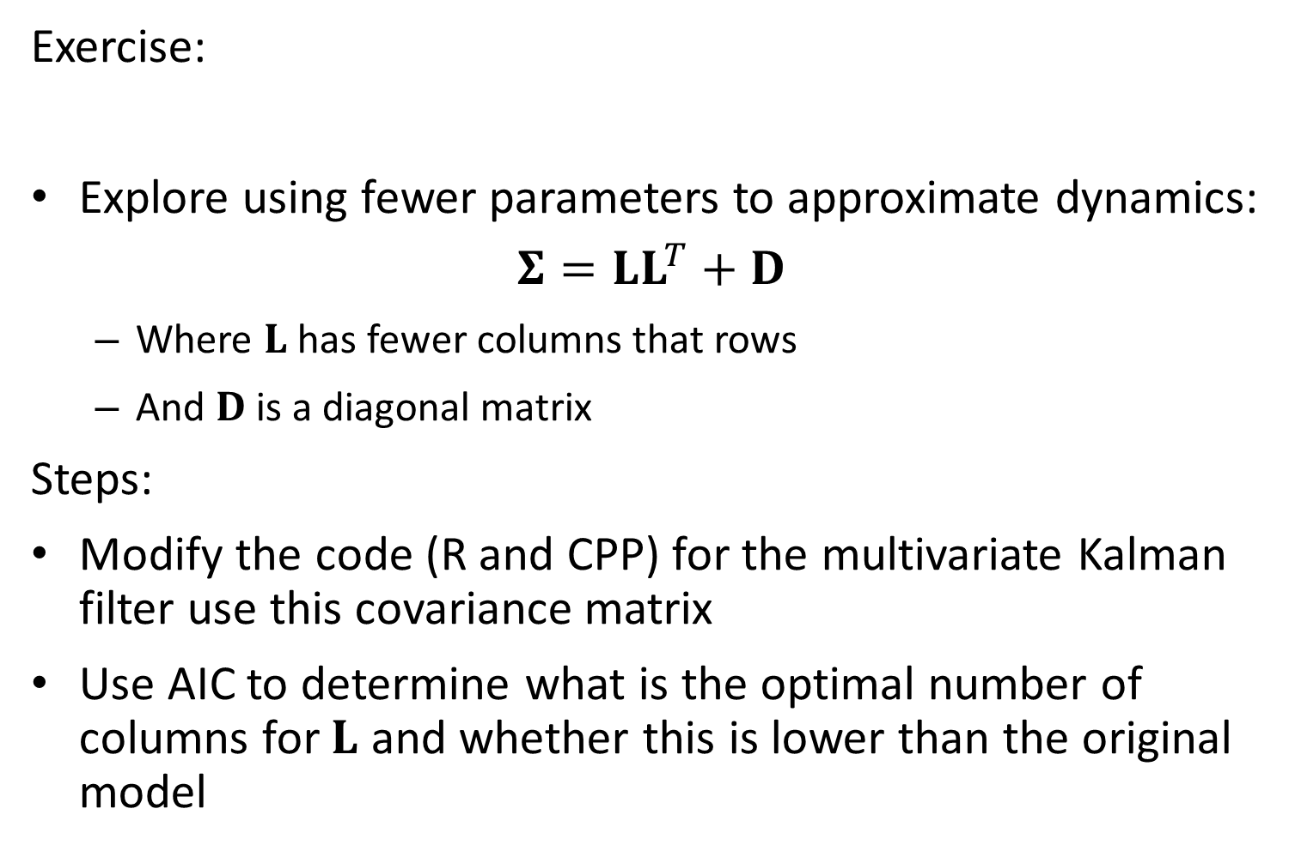
Exercise:
Explore using fewer parameters to approximate dynamics:
$$Σ=LL^{T}+D$$
Where $L$ has fewer columns that rows
And $D$ is a diagonal matrix
Steps:
Modify the code (R and CPP) for the multivariate Kalman filter use this covariance matrix
Use AIC to determine what is the optimal number of columns for $L$ and whether this is lower than the original model

Slide 19
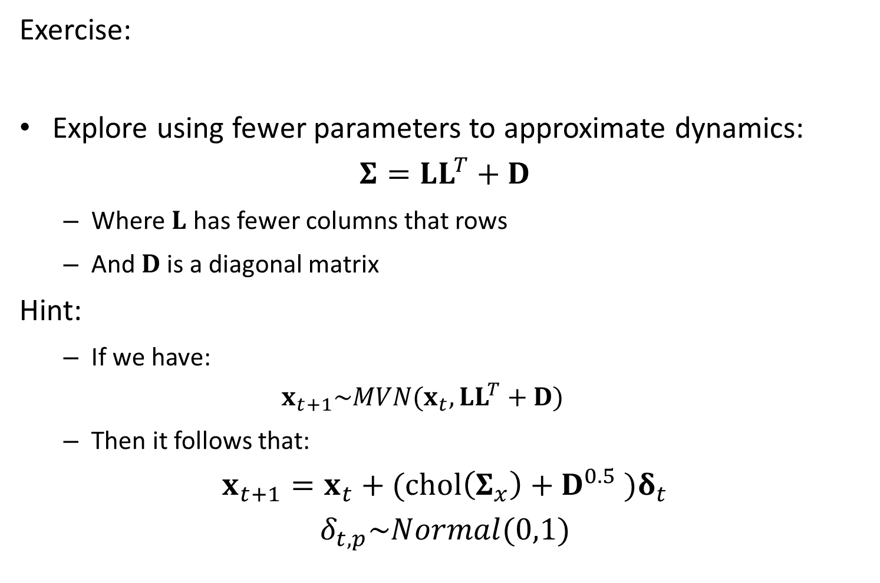
Exercise:
Explore using fewer parameters to approximate dynamics:
$$Σ=LL^{T}+D$$
Where $L$ has fewer columns that rows
And $D$ is a diagonal matrix
Hint:
If we have:
$$x_{t+1}\sim MVN(x_{t},LL^{T}+D)$$
Then it follows that:
$$x_{t+1}=x_{t}+(chol\left(Σ_{x}\right)+D^{0.5} )δ_{t}$$
$$δ_{t,p}\sim Normal(0,1)$$

